Slide 1
HTML Graphics and Media
Module 8

Slide 2
HTML Canvas

Slide 3

What is HTML Canvas?
The <canvas> element is used to draw graphics with JavaScript
The <canvas> element is a container for a graphic, but JavaScript actually creates the graphics
<canvas> elements have built-in methods for JavaScript to use to draw paths, boxes, circles, text, etc

Slide 4

Canvas Examples
A canvas is a rectangle on your screen with no borders or content
Since you will need JavaScript to draw on your canvas, be sure to give it an ID so it can be selected
Just like images, canvases should be given a width and height

Slide 5
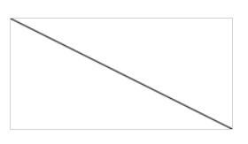
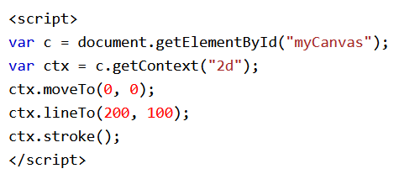
Adding JavaScript
After you create the canvas area to draw in, you must write JavaScript either inside of the <script> element, or in an external JS file
You don’t need to know how to write any JavaScript yet, but you will need to know about some of the methods

